Slide 1
Outline
Impedance Matching
Single Stub Matching
Matching With Lumped Elements
Quarter Wavelength Transformer
Theory of Small Reflections
Multi-Sectional Transformer
Tapered Line
Bode-Fano Criterion

Slide 2
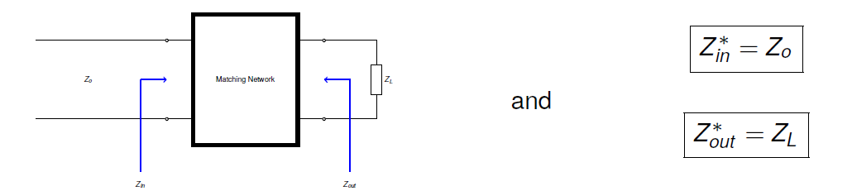
Impedance Matching
Max. power transfer condition

Slide 3
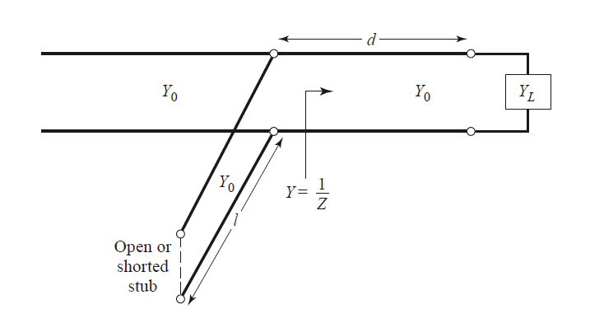
Single Stub Matching
One of the most common matching techniques at f > 3 GHz
Very low loss and does not occupy a lot of space on the circuit
Short (open) stub can only result in a reactive element

Slide 4
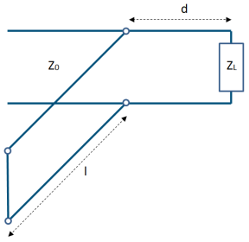
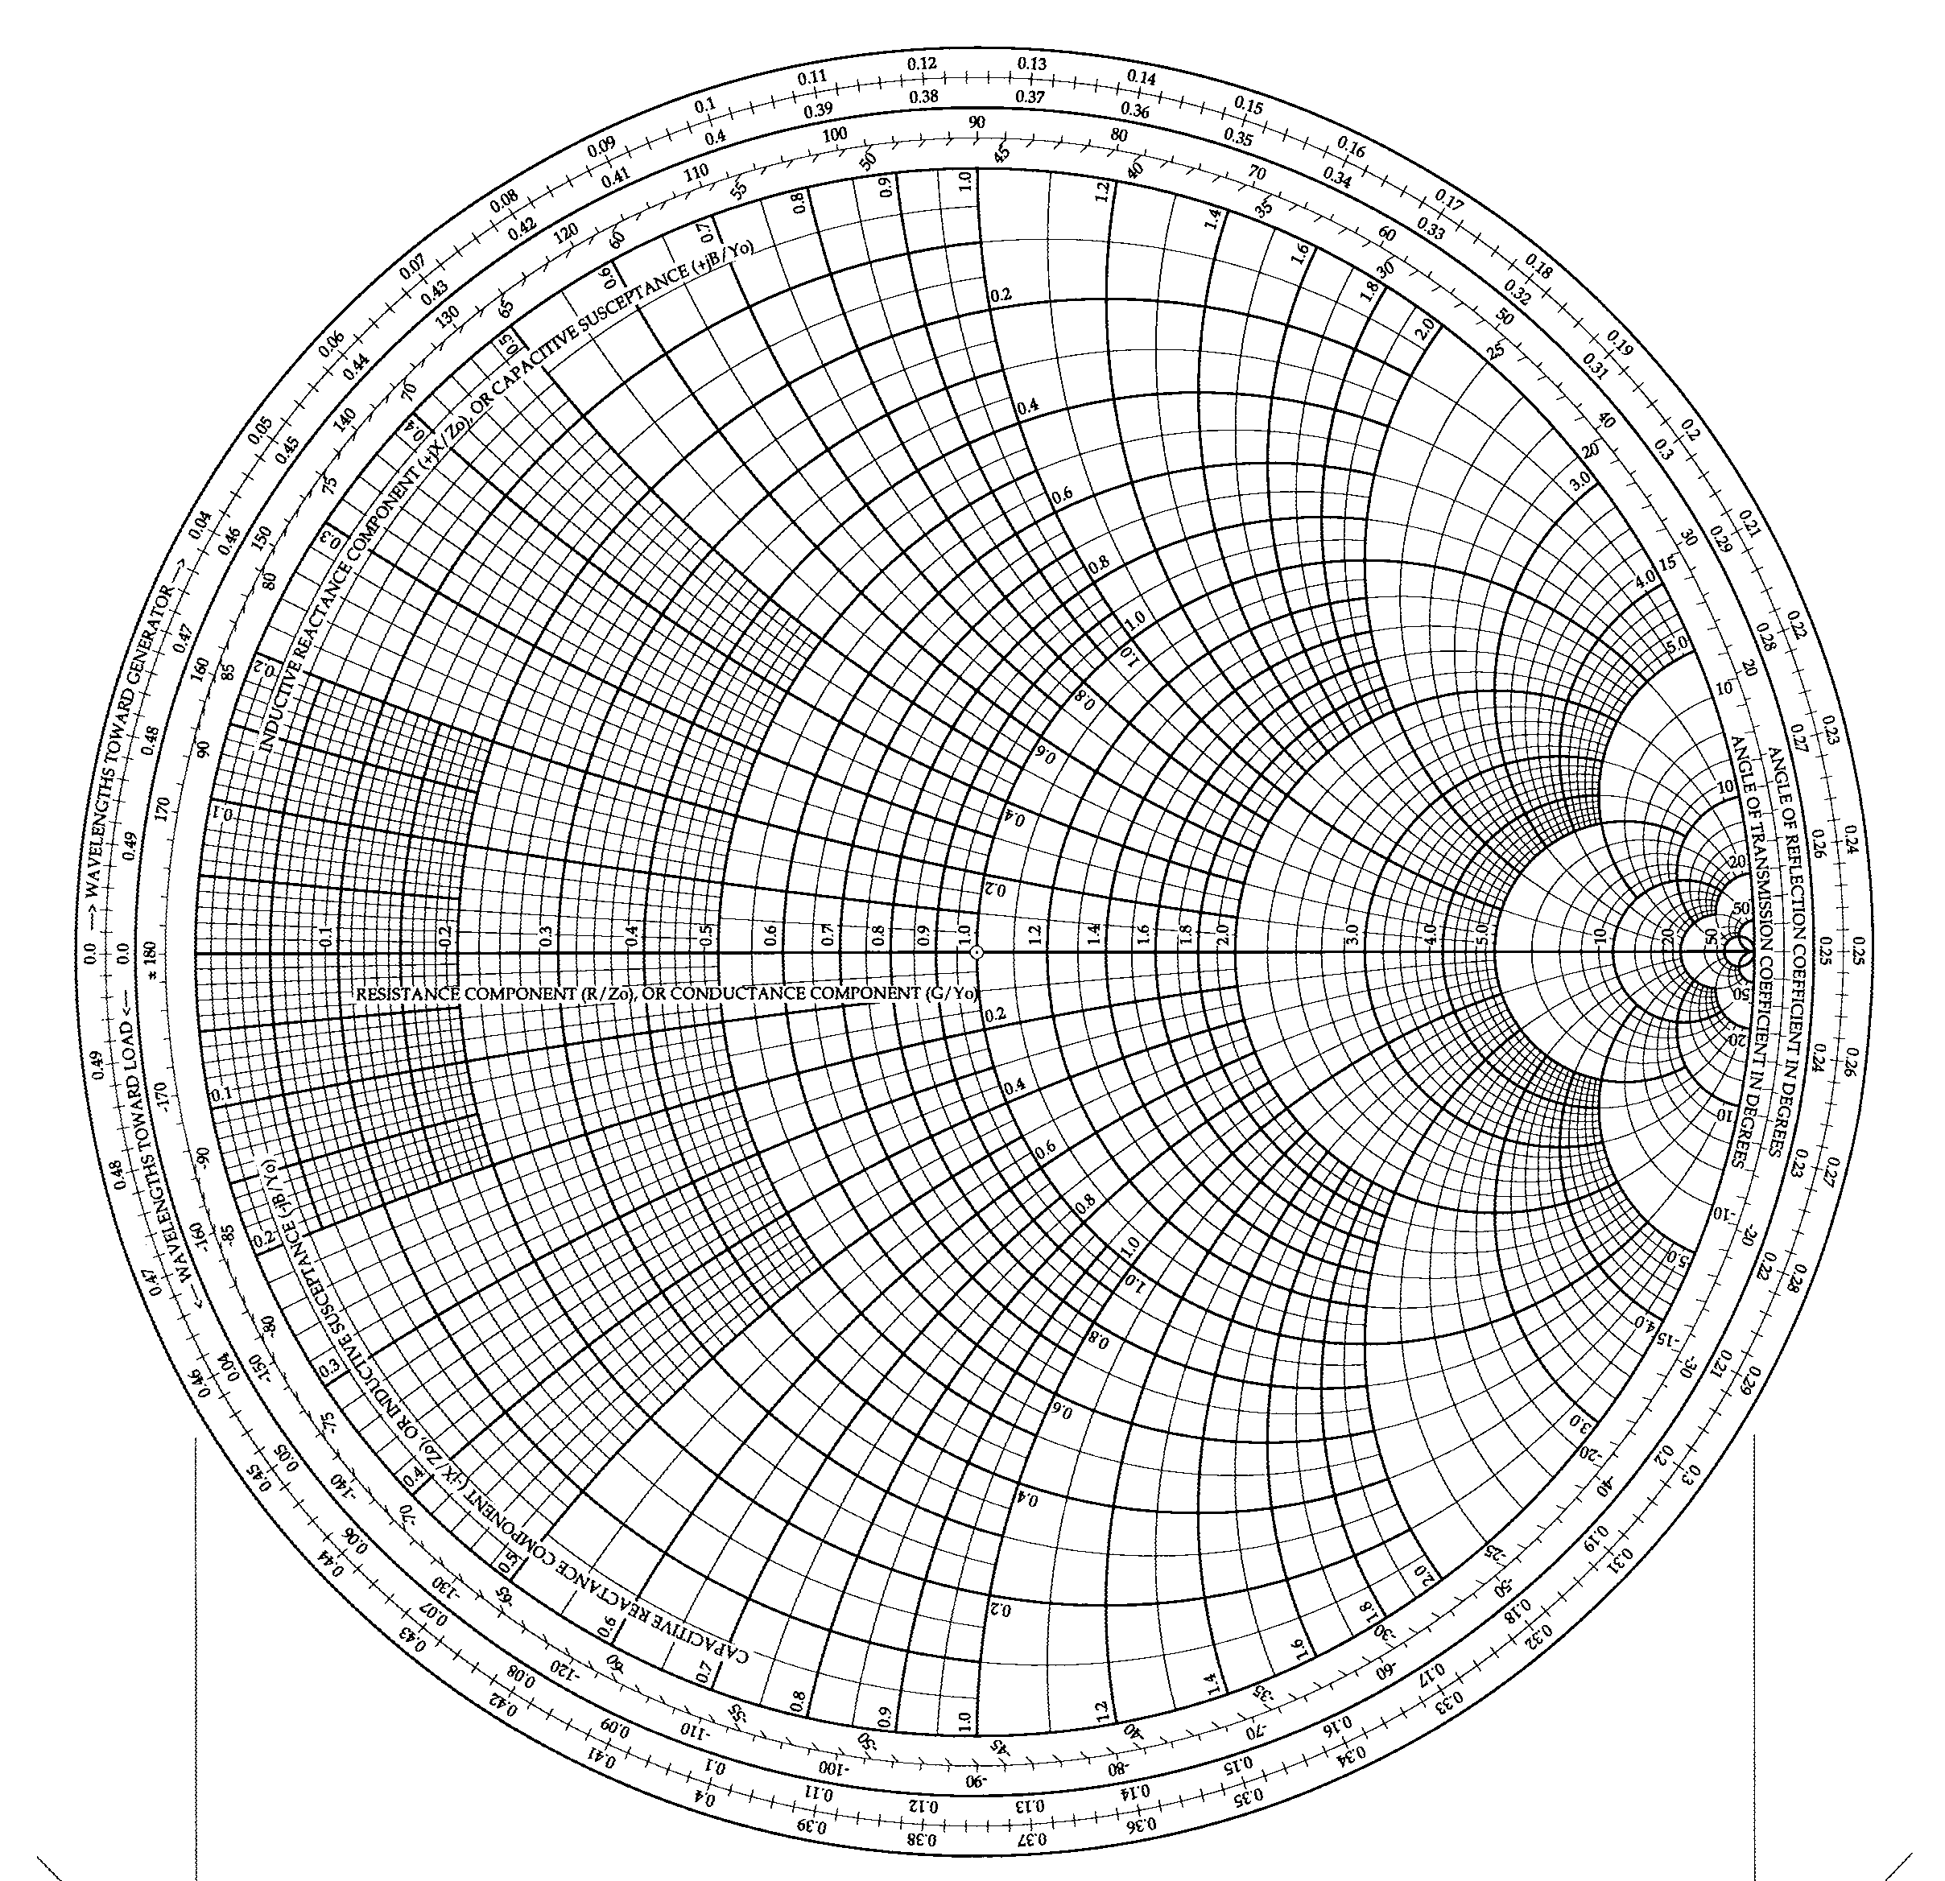
Single Stub Matching
Z_{l} =60 – j80(Ω)
Z₀ =50 (Ω)
l₂
d₁
z_{l} =1.2 – j1.6
y₁
y_{l} =0.3 + j0.4
d₁ =0.176-0.065=0.110λ
y₁ =1+j1.47
d₂
d₂ =0.325-0.065=0.260λ
y₂ =1-j1.47
y₂
l₁ =0.095λ
l₂ =0.405λ
l₁

Slide 5
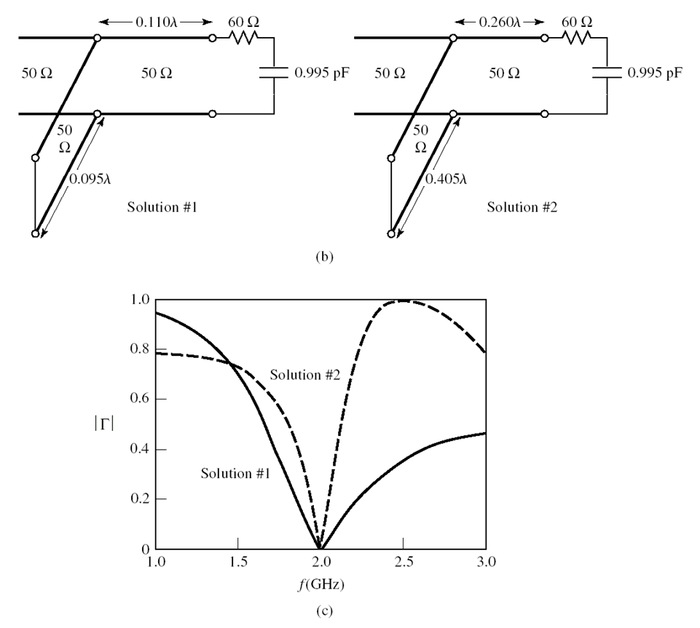
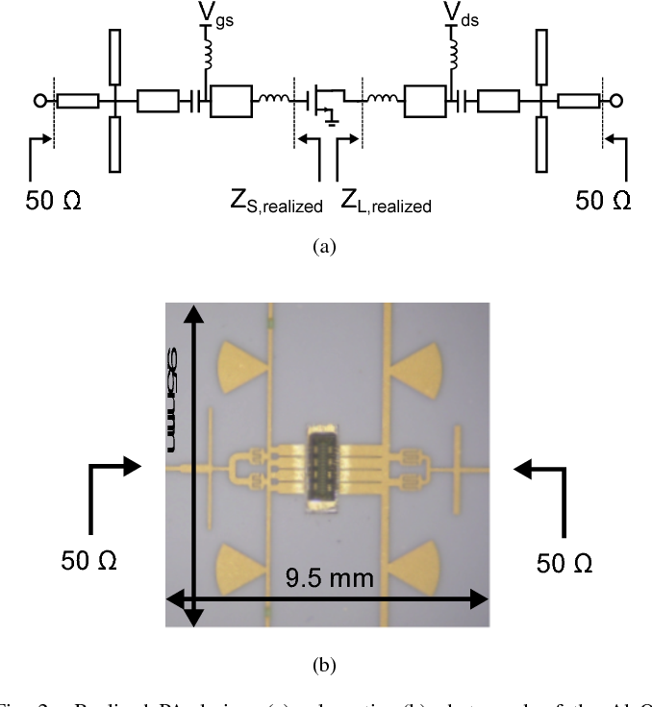
Single Stub Matching
A 12-W GaN-HEMT power amplifier for Ku-band satellite communication

Slide 6
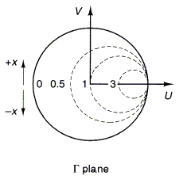
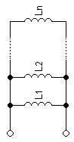
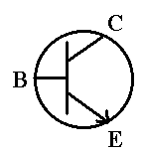
Lumped Element Matching
Used extensively at low frequencies (300 MHz – 3 GHz)
Use Inductor/Capacitor to match any impedance
Case 1: series inductor (widely used in transistor matching)
|Γ|=-10 dB
Z_{l}=1-jX
Allowable Z_{l}

Slide 7
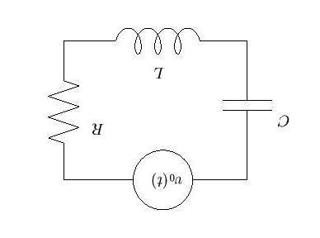
Lumped Element Matching
Case 2: Shunt Capacitor
Y chart
Z chart
Y_{l}=1-jB

Slide 8
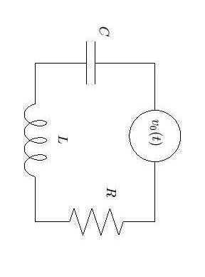
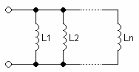
Lumped Element Matching
Case 3: Shunt Inductor
Case 4: Series Capacitor
Z_{l}=1-jX
Y_{l}=1-jB
The range of matching is limited by using one component.

Slide 9
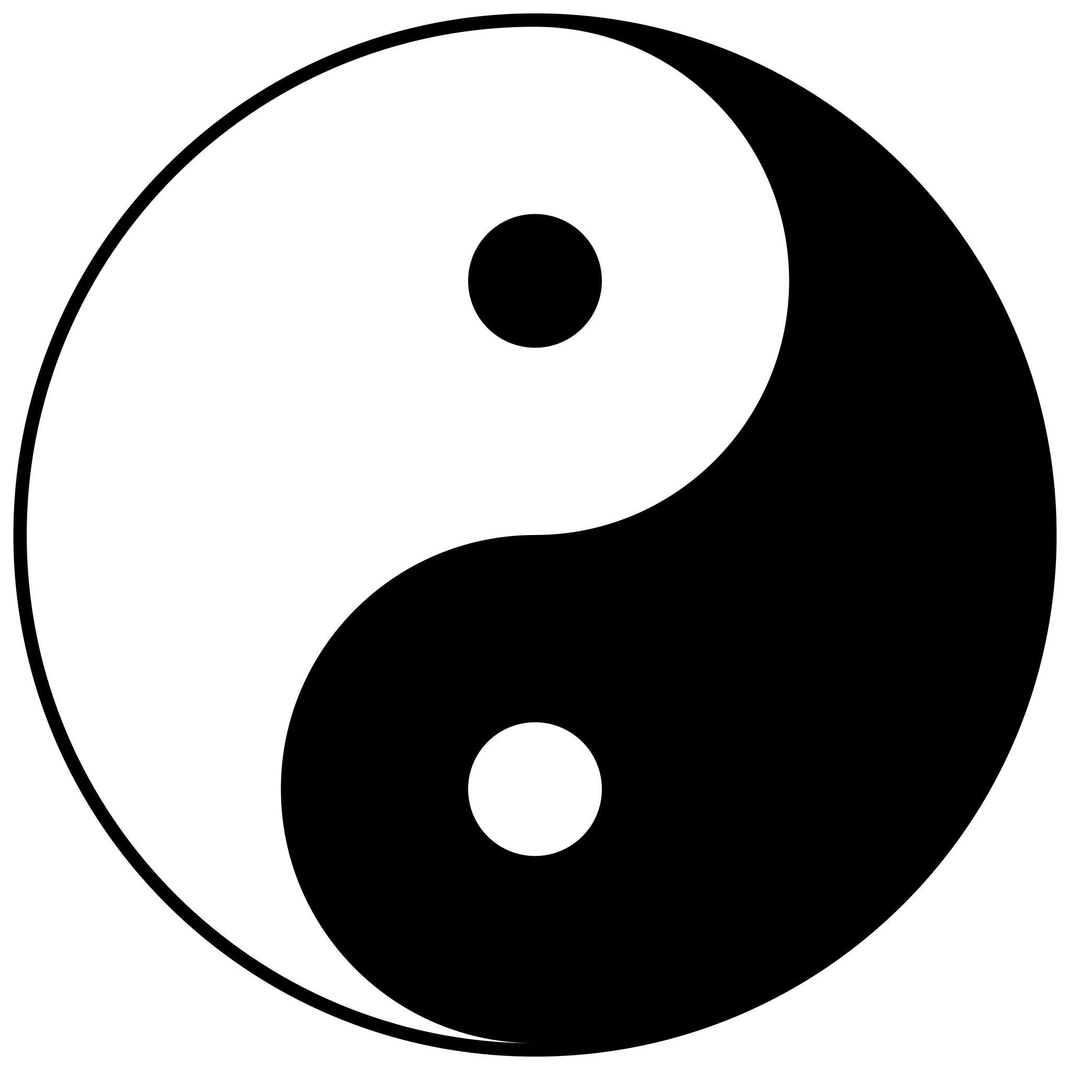
Lumped Element Matching
In Ancient Chinese philosophy, yin and yang (/jɪn/ and /jɑːŋ, jæŋ/; Chinese: 陰陽 yīnyáng pronounced [ín jǎŋ], lit. "dark-light", "negative-positive") is a concept of dualism, describing how obviously opposite or contrary forces may actually be complementary, interconnected, and interdependent in the natural world, and how they may give rise to each other as they interrelate to one another.^{[1]}

Slide 10
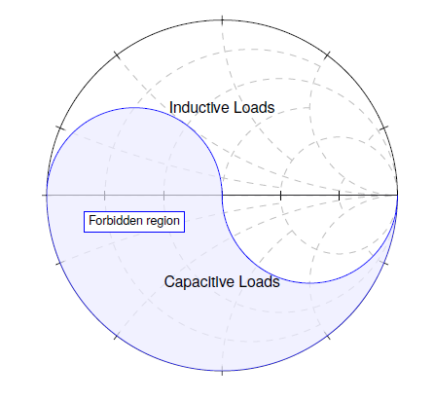
Lumped Element Matching
Case 5: shunt capacitor first Series Inductor second
Z_{l}
Z₀
Z_{l}
Allowable Z_{l}
Z₂=1-jX
Find Y2
Cross with Re(Y_{l}) circle
Allowable Y_{l}

Slide 11
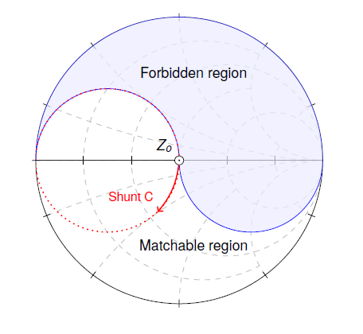
Lumped Element Matching
Case 6: Series Inductor first shunt capacitor second
Z_{l}
Z0
Zl
Allowable Y_{l}
Y₂=1-jB
Find Z₂
Cross with Re(Z_{l}) circle
Allowable Z_{l}

Slide 12
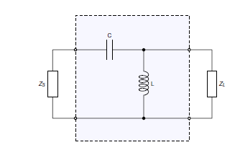
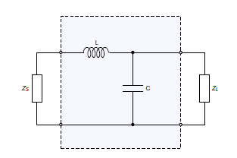
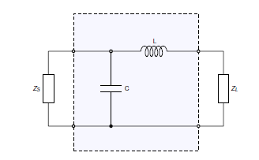
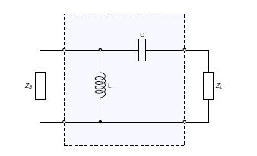
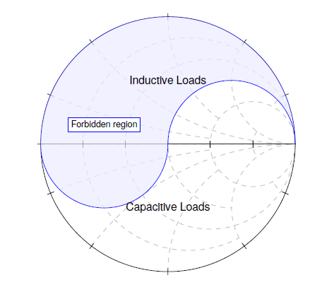
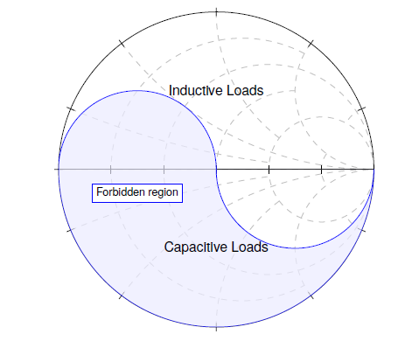
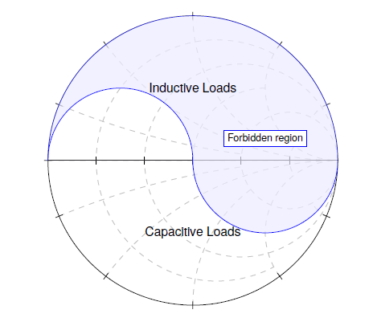
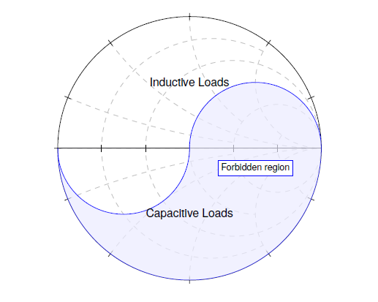
Lumped Element Matching

Slide 13
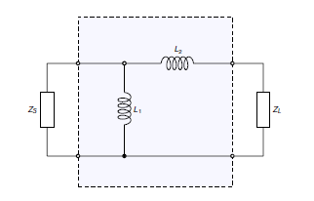
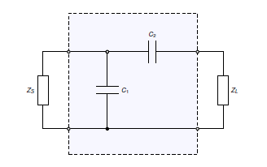
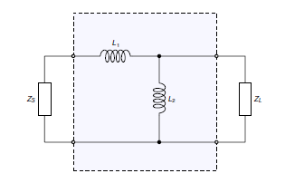
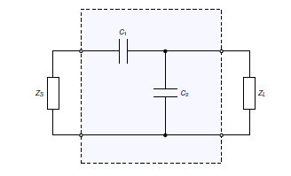
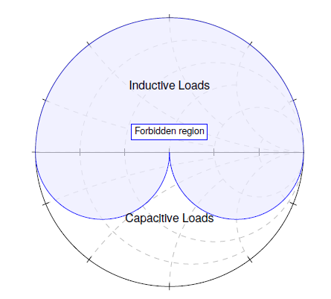
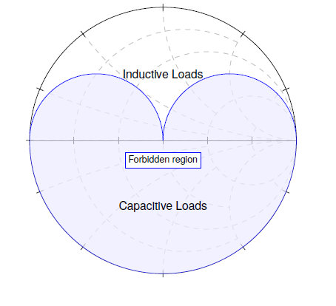
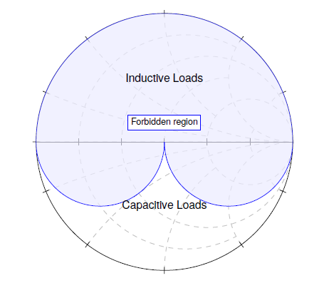
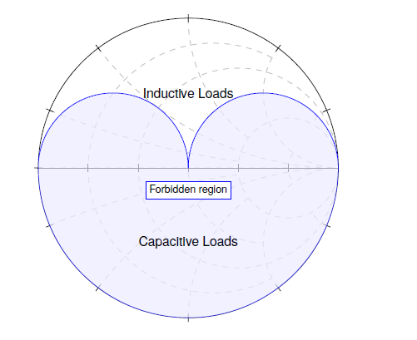
Lumped Element Matching

Slide 14
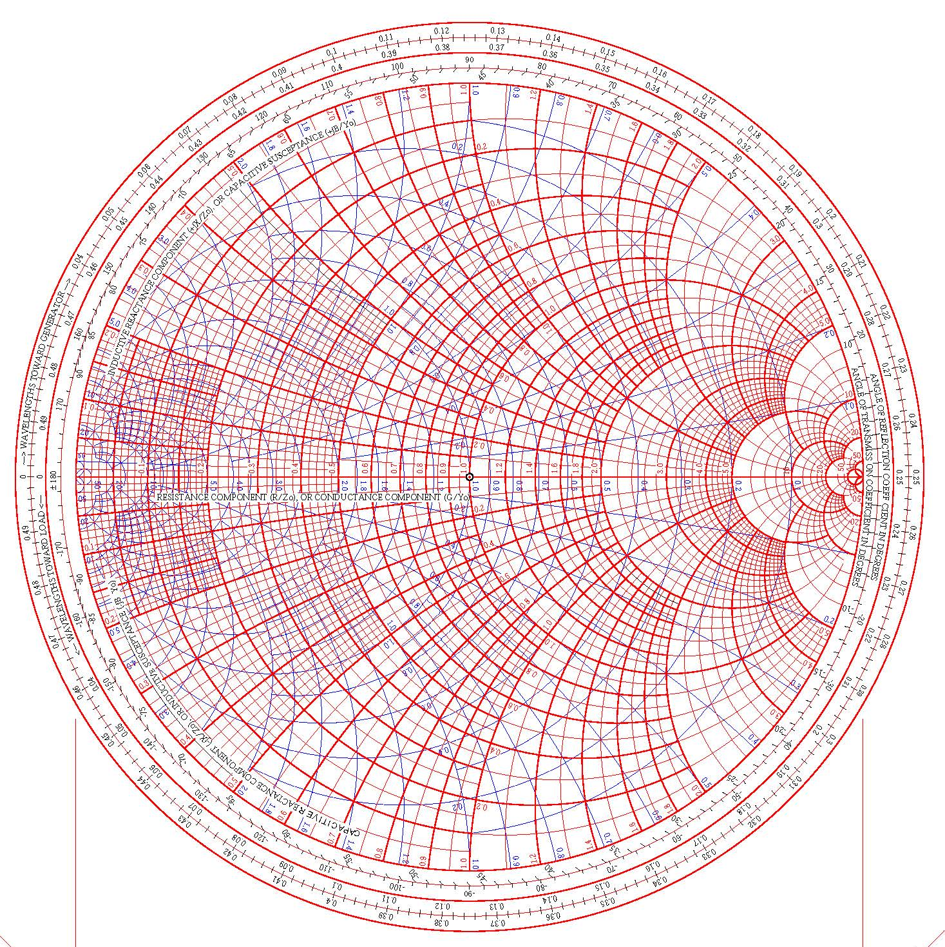
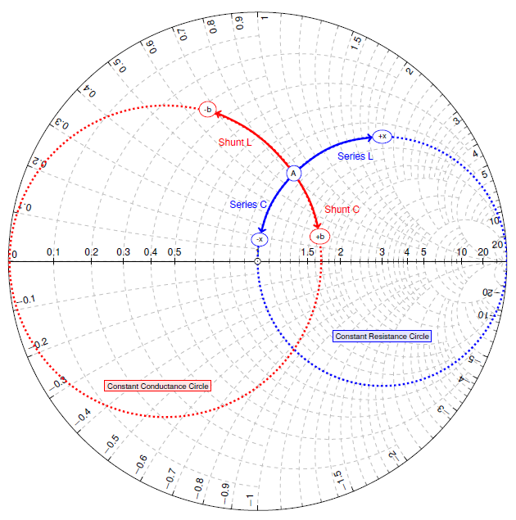
Effects of Adding L and C

Slide 15
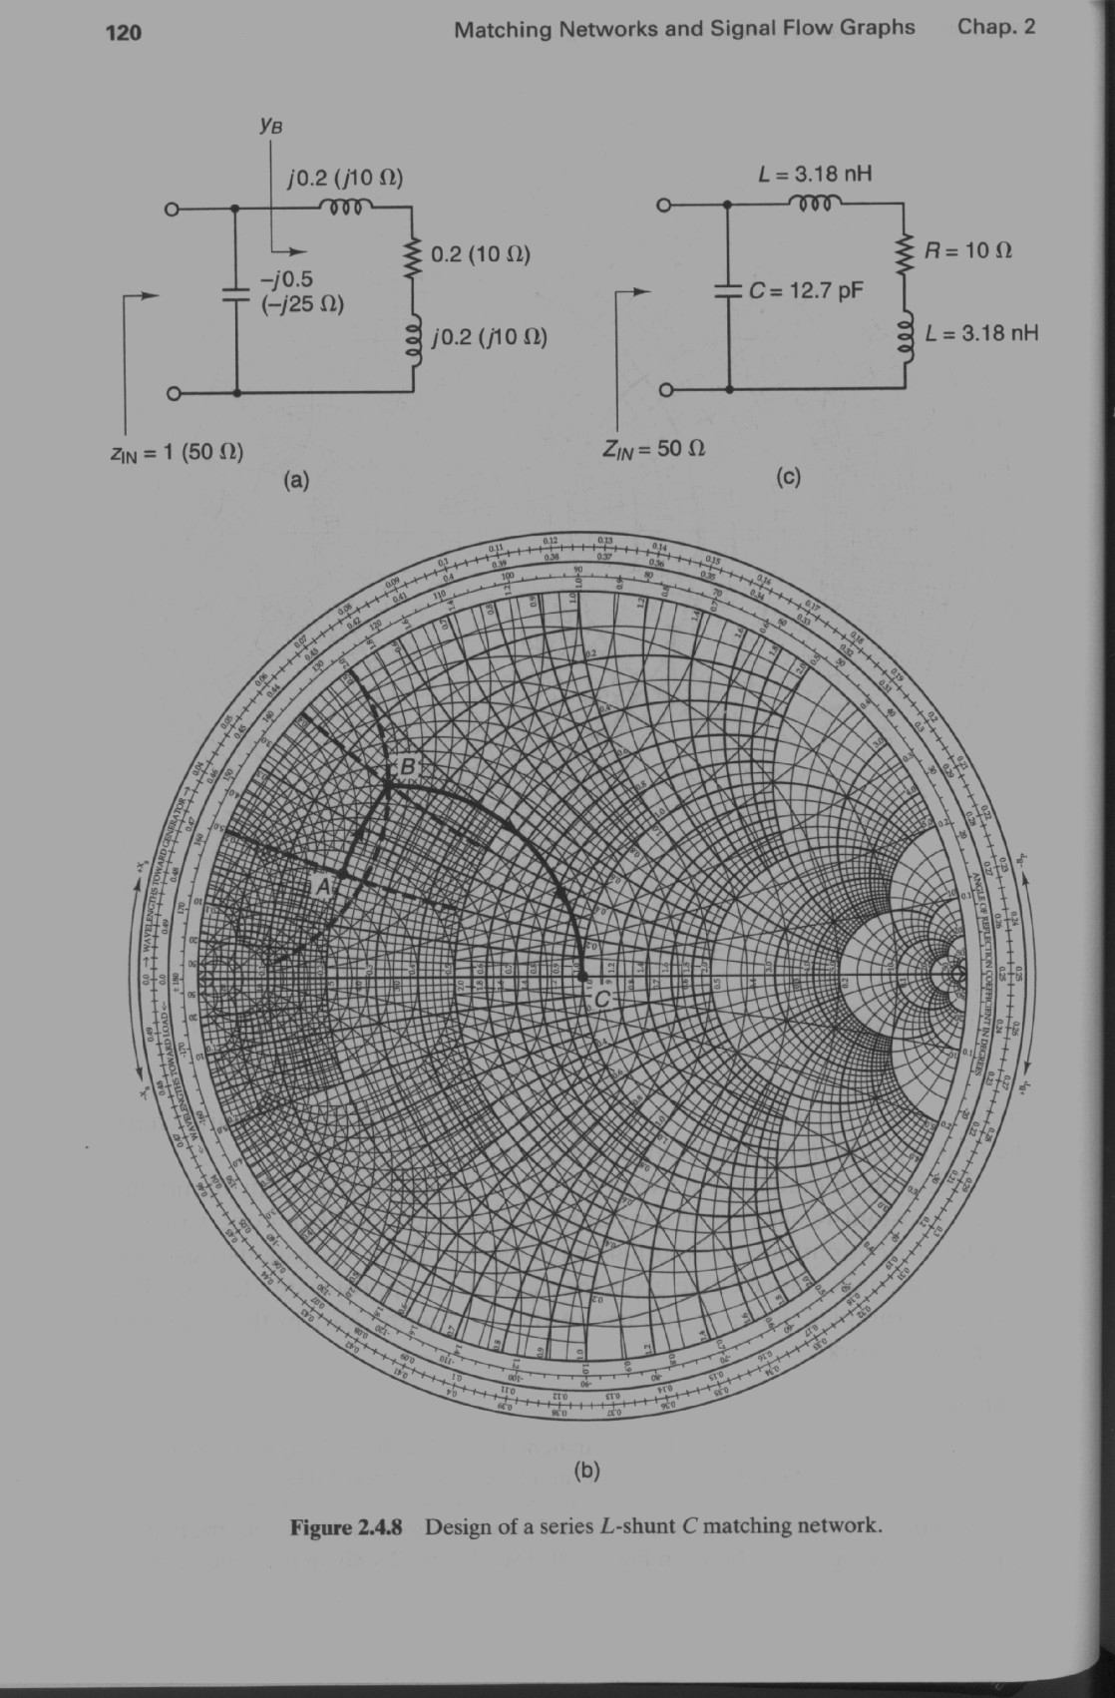
Lumped Element Matching

Slide 16
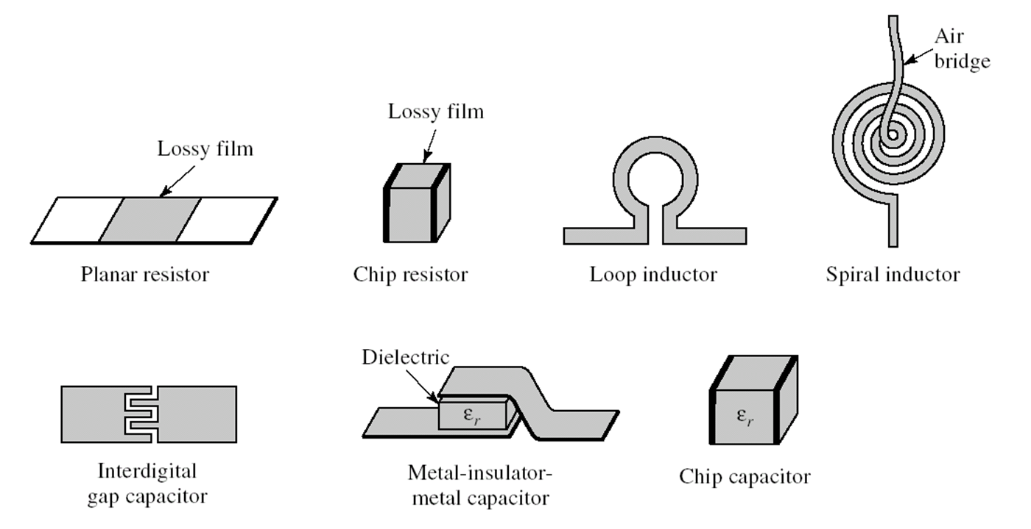
Lumped Element Matching
Case 5 & 6 together covers the whole smith chart
Q(inductor)<100 for off chip component
Q(indcutor)<20 for on chip component
Q(capacitor)<100 for Metal-insulator-metal capacitance

Slide 17
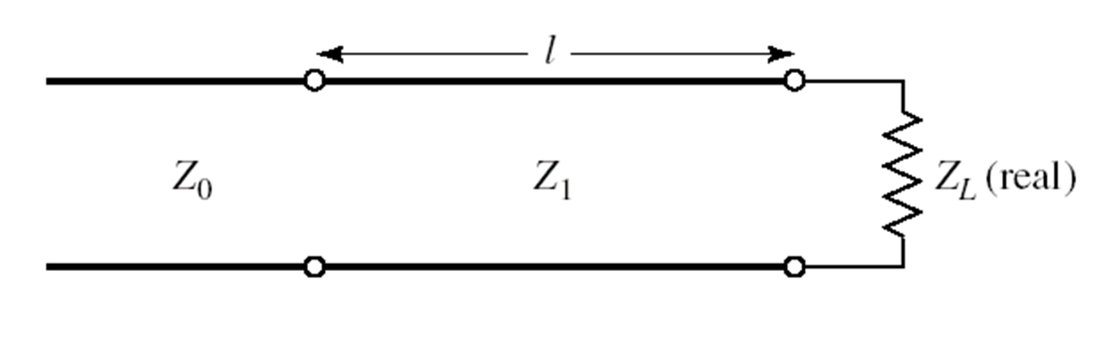
Quarter Wavelength Transformer

Slide 18
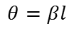
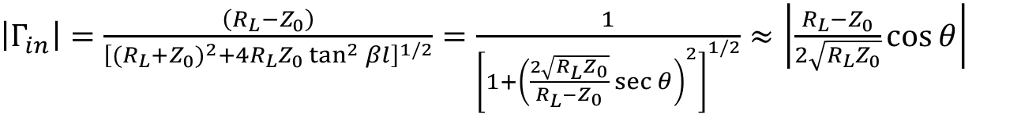
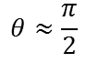
Bandwidth (BW) Considerations
0
$$θ≈\frac{π}{2}$$
$$θ=βl$$
$\left|Γ_{in}\right|=\frac{\left(R_{L}−Z_{0}\right)}{{\left[{{(R}_{L}+Z_{0})}^{2}+4R_{L}Z_{0}\tan^{2}{βl}\right]}^{1/2}}=\frac{1}{{\left[1+{\left(\frac{2\sqrt{R_{L}Z_{0}}}{R_{L}−Z_{0}}\sec{θ}\right)}^{2}\right]}^{1/2}}≈\left|\frac{R_{L}−Z_{0}}{2\sqrt{R_{L}Z_{0}}}\cos{θ}\right|$

Slide 19
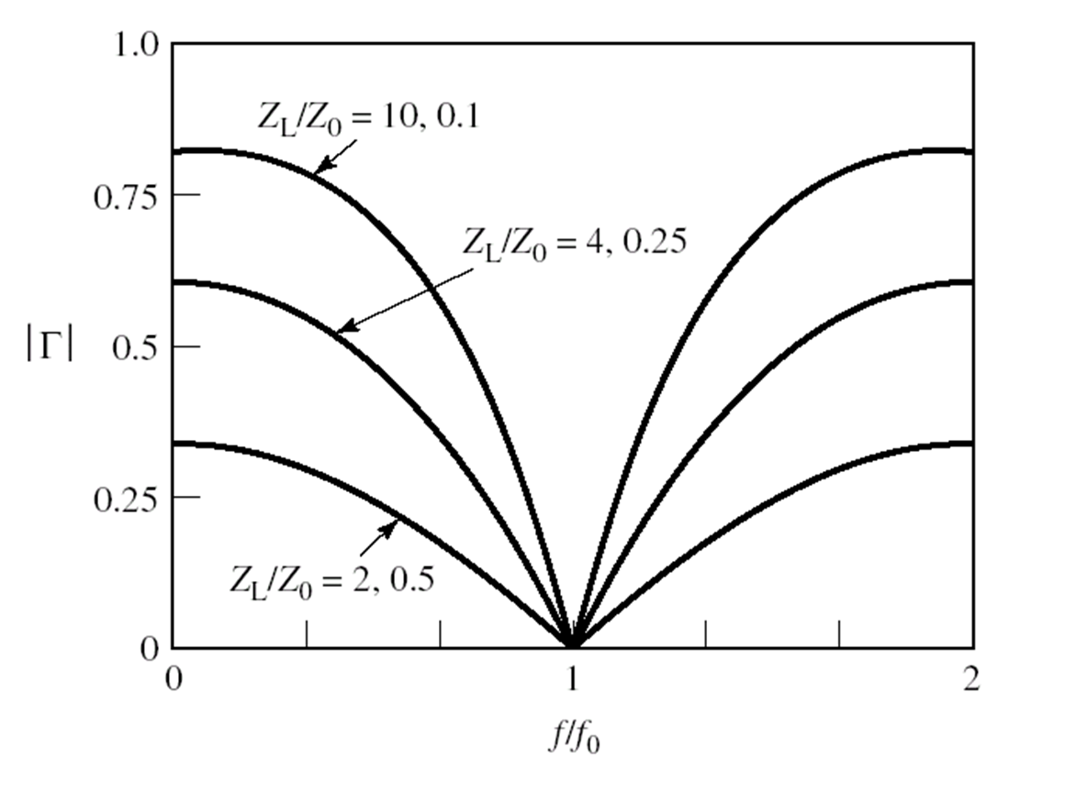
Bandwidth (BW) Considerations

Slide 20
Bandwidth (BW) Considerations

Slide 21
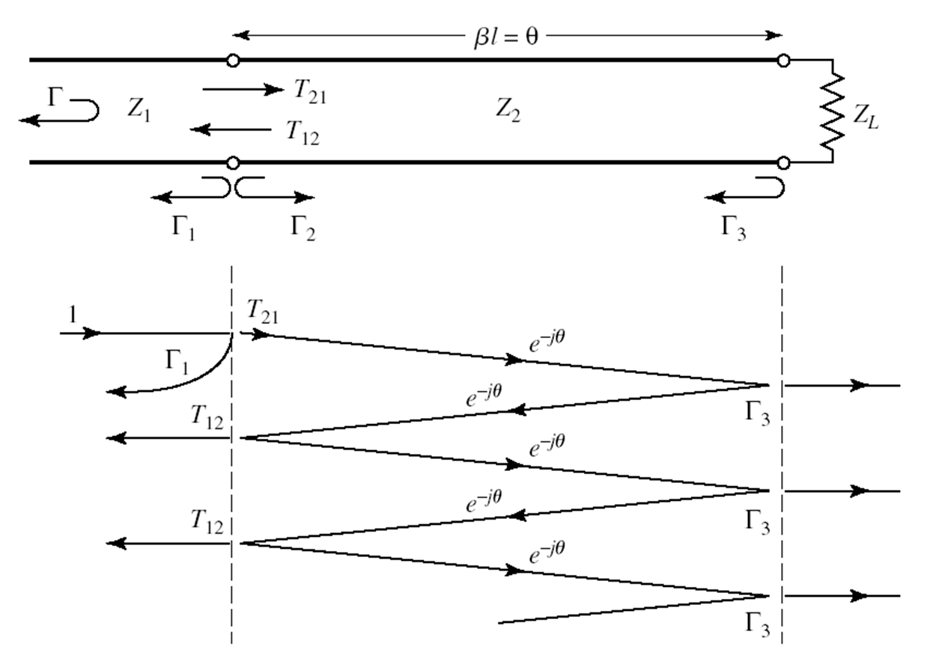
Theory of Small Reflections

Slide 22
Theory of Small Reflections

Slide 23
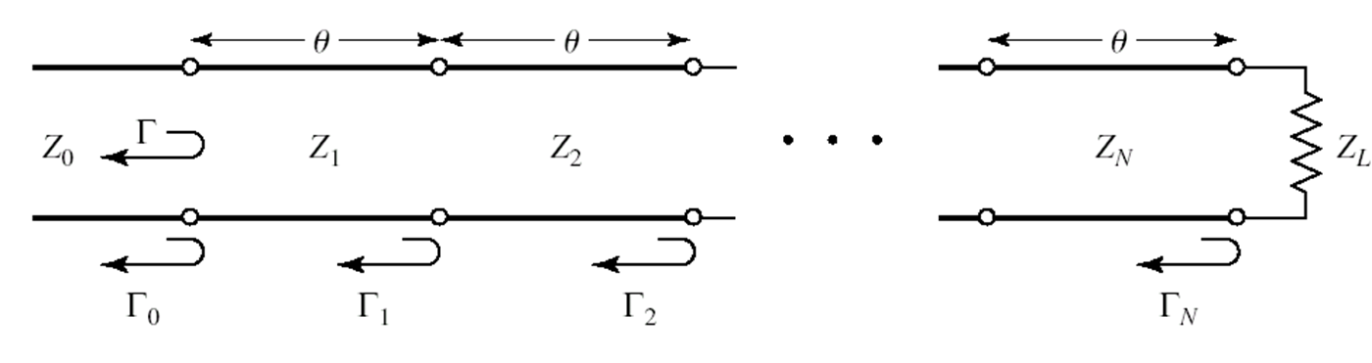
Multi-Section Transformer

Slide 24
Multi-Section Transformer

Slide 25
Multi-Section Transformer

Slide 26
Multi-Section Transformer

Slide 27
Multi-Section Transformer

Slide 28
Multi-Section Transformer

Slide 29
Multi-Section Transformer

Slide 30
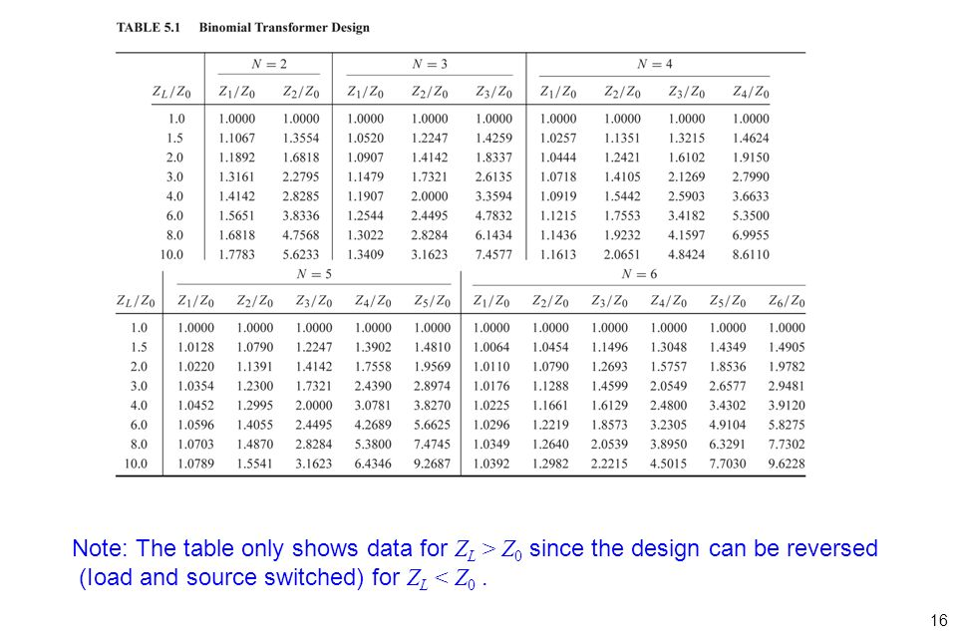
Multi-Section Transformer

Slide 31
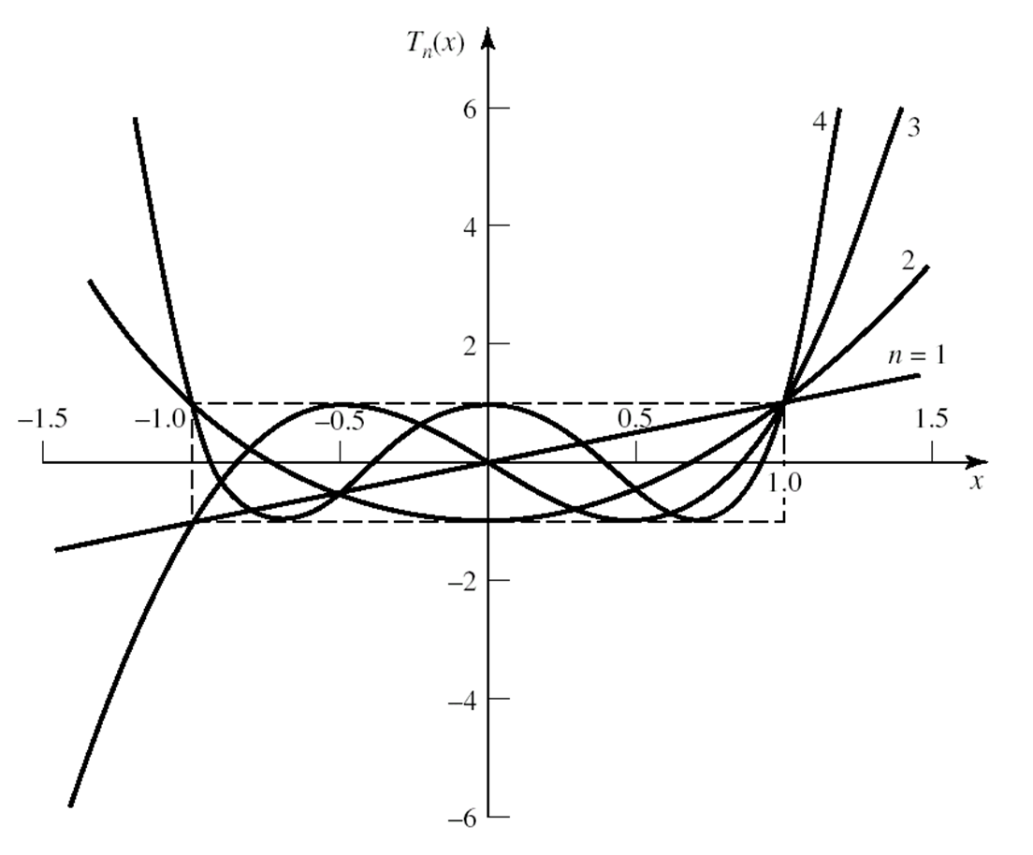
Multi-Section Transformer

Slide 32
Multi-Section Transformer

Slide 33
Multi-Section Transformer

Slide 34
Multi-Section Transformer

Slide 35
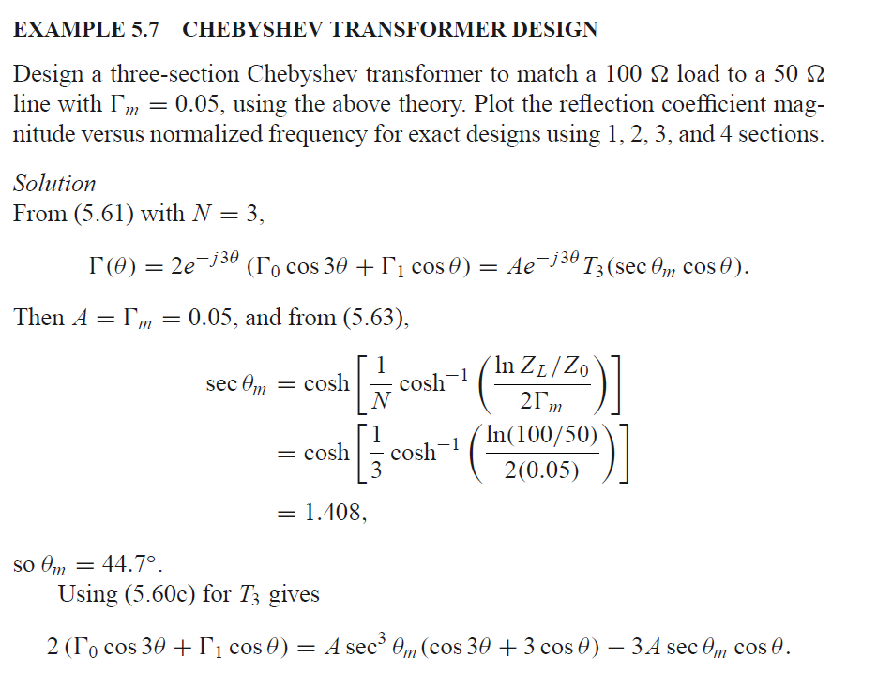
Multi-Section Transformer

Slide 36
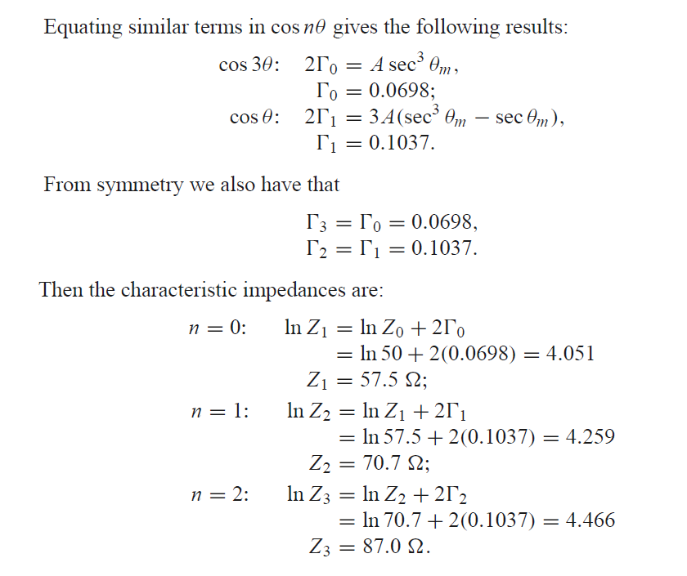
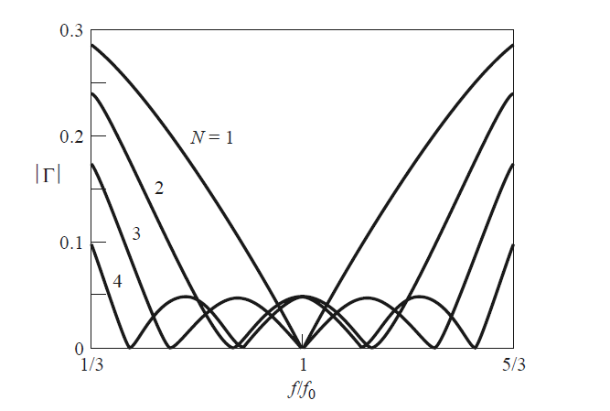
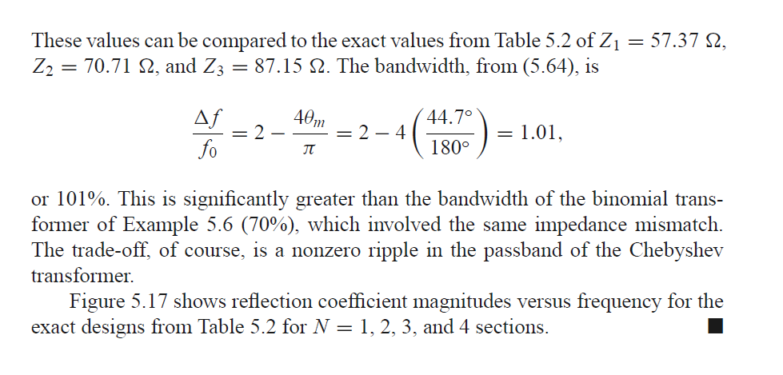
Multi-Section Transformer

Slide 37
Multi-Section Transformer

Slide 38
Tapered Lines

Slide 39
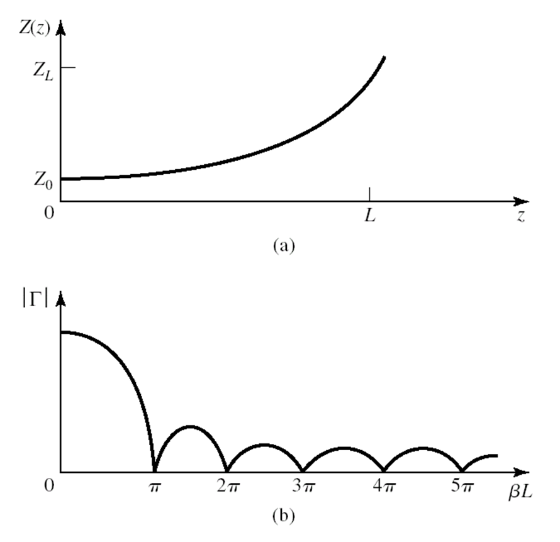
Tapered Lines

Slide 40
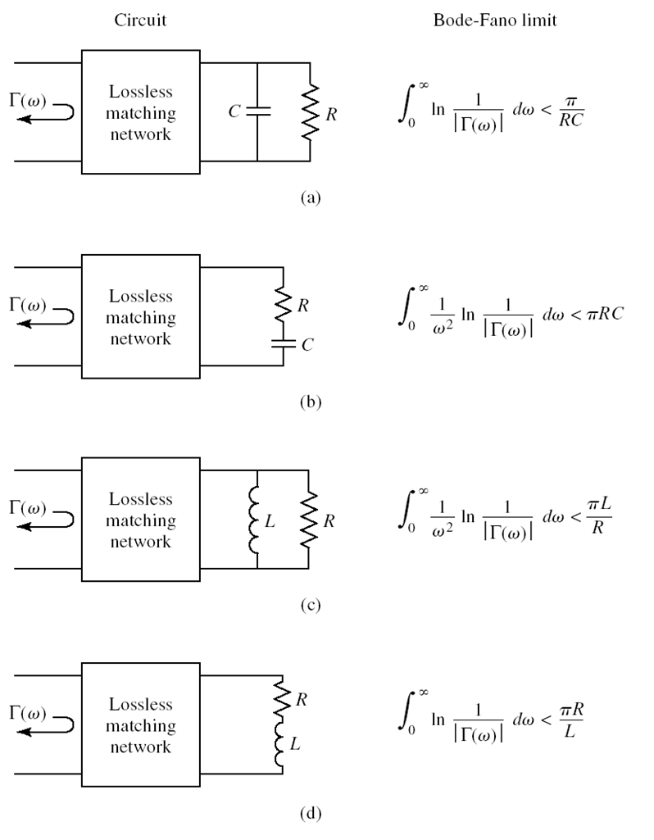



Bode-Fano Criterion
$$∆ω\ln{\frac{1}{Γ_{m}}}≤\frac{π}{RC}$$
For a given load, wider bandwidth can be achieved only at the expenses of a higher Γ_{m} in the passband
Γ_{m} cannot be zero unless $∆ω$ = 0. Thus, a perfect matching can only be achieved at a finite number of frequencies.

Slide 41


Bode-Fano Criterion
For a parallel RC network,
$$Q=ωRC$$
Therefore, the Bode-Fano limit can be expressed as:
$\frac{πω}{Q}$
The higher the Q factor, the narrower the bandwidth.
The same conclusion applies to the other three cases.

